Slide 1
Introduction to Public Health
Module # 16
Food safety and security
DR. SHAIKH ABDUS SALAM
Dept. of Public Health
North south University

Slide 2
OBJECTIVES OF THE LECTURE
By the end of this lecture you will be able to:
Conceptualize Food Safety and Food Security
  Food adulteration and food contamination
  Health impacts of food adulteration
  How foods are adulterated and contaminated
Identify the levels of prevention of food adulteration and food contamination.
September 22, 2014

Slide 3
“Food security exists when all people, at all
times, have physical and economic access to
sufficient, safe and nutritious food to meet their
dietary needs and food preferences for an active
and healthy life”
World Food Summit – 1996
Dr. Shaikh Abdus Salam

Slide 4
The words ‘food security’ mean that everybody is able to get enough healthy food to be well and active.
For everybody to get enough healthy food, we need a food system that works well.
FOOD SYSTEM
Five parts of the food system:
Production
Distribution
Access
Consumption
Disposal (as waste).
When all the parts of the food system are working well together, we have food security.
Dr. Shaikh Abdus Salam

Slide 5
(a) availability of food means food production within the country, food imports and the previous years stock stored in government granaries.
(b) accessibility means food is within reach
of every person.
(c) affordability implies that an individual
has enough money to buy sufficient,
safe and nutritious food to meet one's
dietary needs.
Dr. Shaikh Abdus Salam

Slide 6
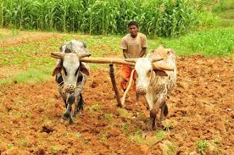
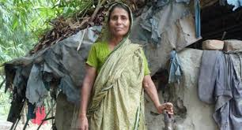
For the poor sections of the society
Dr. Shaikh Abdus Salam

Slide 7

Earthquake
Dr. Shaikh Abdus Salam

Slide 8
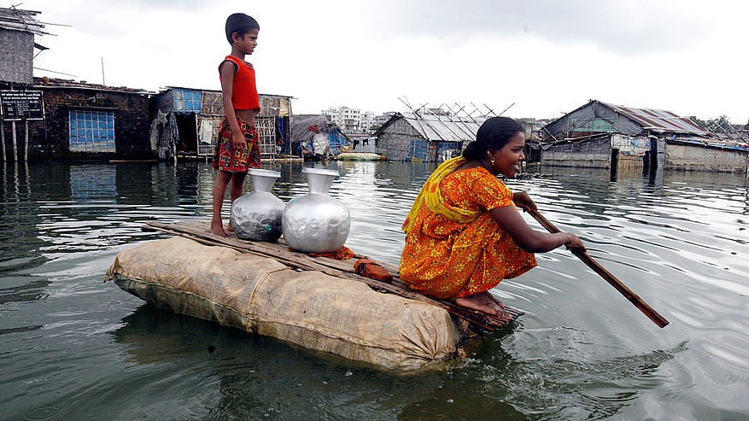
Flood, tsunami
Dr. Shaikh Abdus Salam

Slide 9
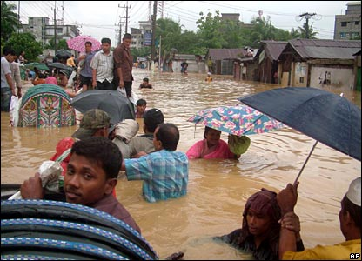
Dr. Shaikh Abdus Salam

Slide 10
A food system that is working well does a few very important things:
It protects the land, water, and air so we can keep producing food.
2. It supports people and businesses to make enough money
to keep working in the food system.
It makes sure that everyone is able to get enough healthy
food.
Dr. Shaikh Abdus Salam

Slide 11
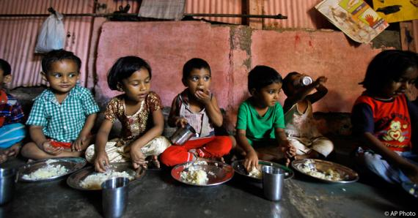
Dr. Shaikh Abdus Salam

Slide 12
Food safety
  Handling, preparation, and storage of food
  To prevent food borne diseases
Food contamination
  Even when hands look clean, they still carry bacteria
  Meat and poultry drippings carry bacteria
  Uncovered coughs and sneezes spread bacteria
  Mishandling of food during preparation, cooking, and storage

Slide 13
Food Contamination
Food contamination refers to the presence in food of harmful chemicals and microorganisms which can cause consumer illness.
Food contamination can occur in many different ways.
Four main causes of food contamination are:
1. Not washing hands
2. Cross-contamination
3. Improper storage and cooking temperatures
4. Contamination by animal waste.
Dr. Shaikh Abdus Salam

Slide 14
Food Contamination
Contaminants include:
Agrochemicals : insecticides, herbicides, rodenticides, etc
Environmental contaminants:
Air: radionuclides (137Caesium, 90Strontium), polycyclic aromatic hydrocarbons (PAH)
Water: arsenic, mercury
Soil: cadmium, nitrates, perchlorates, Polychlorinated biphenyls (PCB)
Packaging materials:
Processing/cooking equipment: copper,
Naturally occurring toxins,
Pesticides and carcinogens: formaldehyde
Hair in food,
Processing contaminants: polycyclic aromatic hydrocarbon etc.
Dr. Shaikh Abdus Salam

Slide 15
Food contamination and diseases
Many foodborne microbes are present in healthy animals (usually in their intestines)
Fresh fruits and vegetables can be contaminated if they are washed or irrigated with water that is contaminated with animal manure or human sewage
Some types of salmonella can infect a hen's ovary so that the internal contents of a normal looking egg can be contaminated

Slide 16
Food processing & diseases
Shigella bacteria, Hepatitis A virus can be introduced by the unwashed hands of food handlers who are themselves infected
In the kitchen, microbes can be transferred from one food to another food by using the same knife, cutting board, or other utensil to prepare both, without washing the surface or utensil in between
Fully cooked food can become recontaminated if it touches other raw foods or drippings from raw foods that contain pathogens.

Slide 17
Given warm moist conditions and an ample supply of nutrients, one bacterium that reproduces by dividing itself every 30 min can produce 17 million progeny in 12 hours. As a result, lightly contaminated food left out overnight can be highly infectious by the next day.
Microbes are killed by heat.

Slide 18
Preventing food contamination
Cook
  To the right temperature
Clean
  Wash hands & surfaces often
Chill
  Refrigerate promptly
Separate
  Raw meat, poultry, seafood, and eggs can spread illness-causing bacteria to ready-to-eat foods—unless they are separated

Slide 19
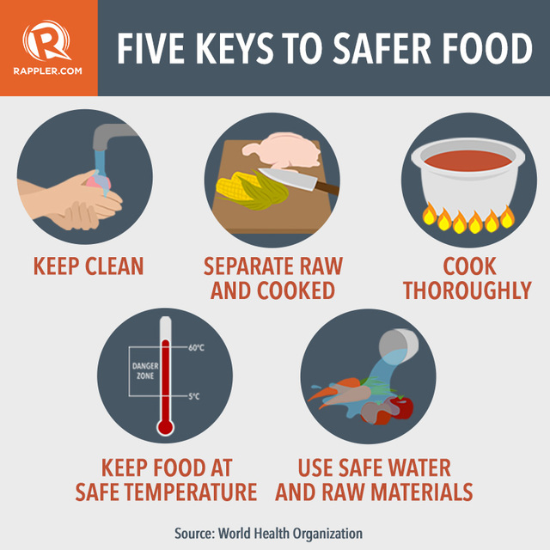

Dr. Shaikh Abdus Salam

Slide 20
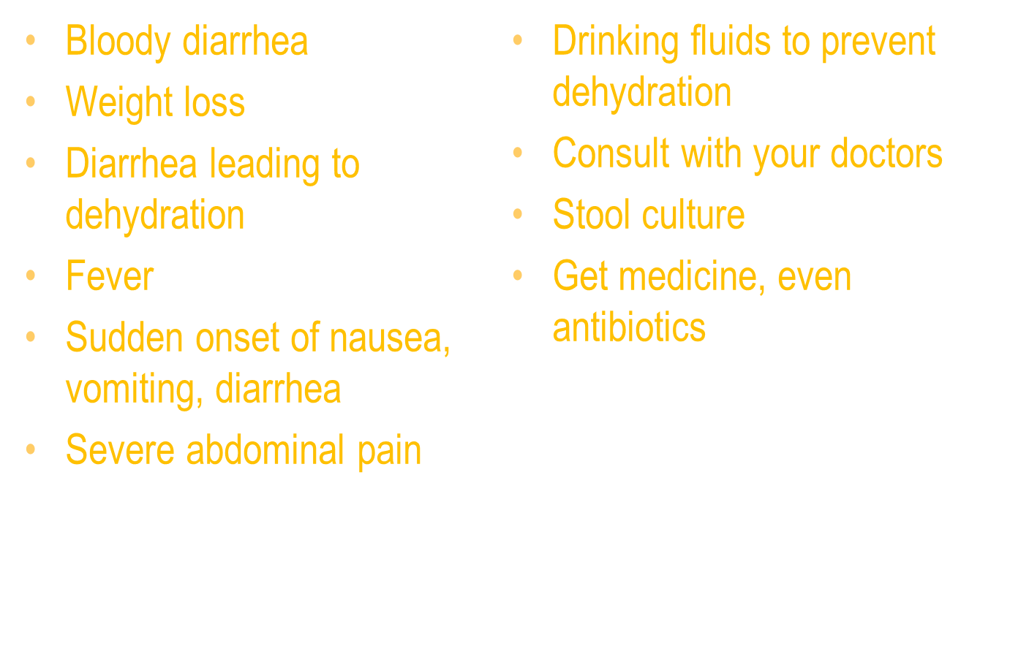
Symptoms & treatment

Slide 21
Food hygiene
WHO- 5 key principles of food hygiene
  Prevent contaminating food with pathogens spreading from people, pets, and pests
  Separate raw and cooked foods to prevent contaminating the cooked foods
  Cook foods for the appropriate length of time and at the appropriate temperature to kill pathogens
  Store food at the proper temperature
  Do use safe water and safe raw materials

Slide 22
Food adulteration
Extraction of valuable components from food or addition of some thing of lower price which is absent in the food normally with an evil motive which lowers the food value and has injurious effect to health is called food adulteration.
Dr. Shaikh Abdus Salam

Slide 23
Food adulteration
Forms of food adulteration:
1) Mixing
2) Substitution
3) Abstraction
4) Concealing the quality
5) putting up decomposed foods for sale
6) Misbranding
7) false labeling
8) Addition of poison/ insecticides /chemicals etc.
Dr. Shaikh Abdus Salam

Slide 24
Food adulteration
Adulterated food is impure, unsafe, or harmful food
Causes:
  Poor harvesting or storage of grain
  Use of banned veterinary products
  Industrial discharges
  Deliberate adulteration and fraud

Slide 25
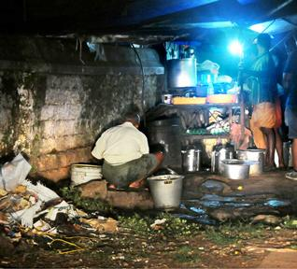

Slide 26
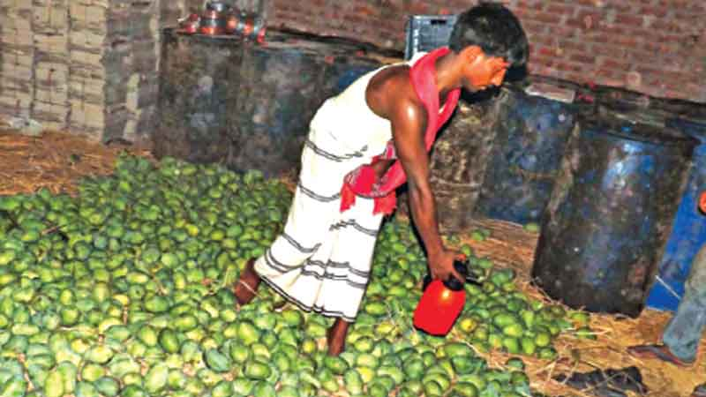

Slide 27
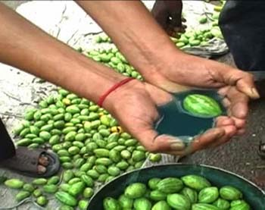

Slide 28
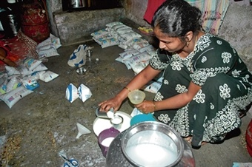

Slide 29
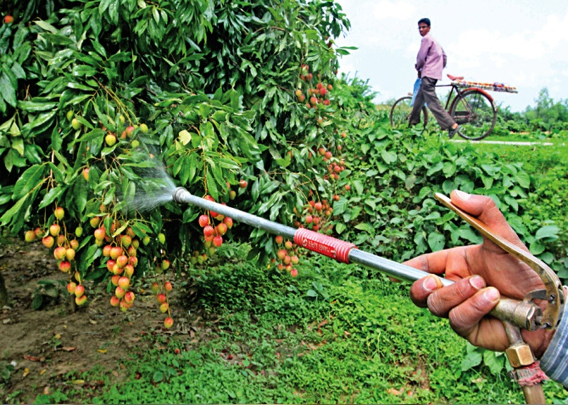

Slide 30
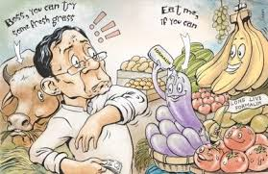

Slide 31
Food adulteration
Prevention of food Adulteration in Bangladesh:
A. Food traders :
B. Food Inspectors:
C. Food Consumers:
D. Health education among the community to create awareness etc.:
Dr. Shaikh Abdus Salam

Slide 32
THANK YOU
Dr. Shaikh Abdus Salam

